Slide 1
Computer Vision In Action
Easy to use deep learning application
Notes:
Ladies and gentlemen. Welcome. Totay let me introduce you to the future of computer vision. I think most people would agree with the following statement:

Slide 2
Deep learning is HARD!
Notes:
Deep learning is hard

Slide 3
Deep learning Applications are very HARD!
Notes:
And deep learning applications are very hard. And when you want to deploy your computer model to the user end, you will face so many situations such as low running speed, hard to pack with dependencies and errors on different operating systems

Slide 4
User friendly Deep learning Applications are very very HARD!
Notes:
Usually, people would say Deploying user friendly deep learning applications is very very very hard!

Slide 5

When start coding
Dependencies, environment setup (cuda), Code structure, bugs ...
Notes:
I think most of you have faced these problems before. When you try to run other code, you got missing dependencies error. And when you want to use a GPU to accelerate your training process, you have a lot of errors on your computer. Especially for those guys using their windows machine.

Slide 6
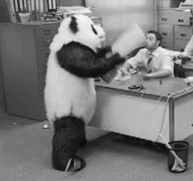
Notes:
However, we are developers, we love solving problems. But for those freshmen in the deep learning world, they will simply give up when they try to step into deep learning.

Slide 7

Solution
Web App With Tensorflow JS
Notes:
And tensorflow JS comes to rescue you. Help you out of the trouble.

Slide 8

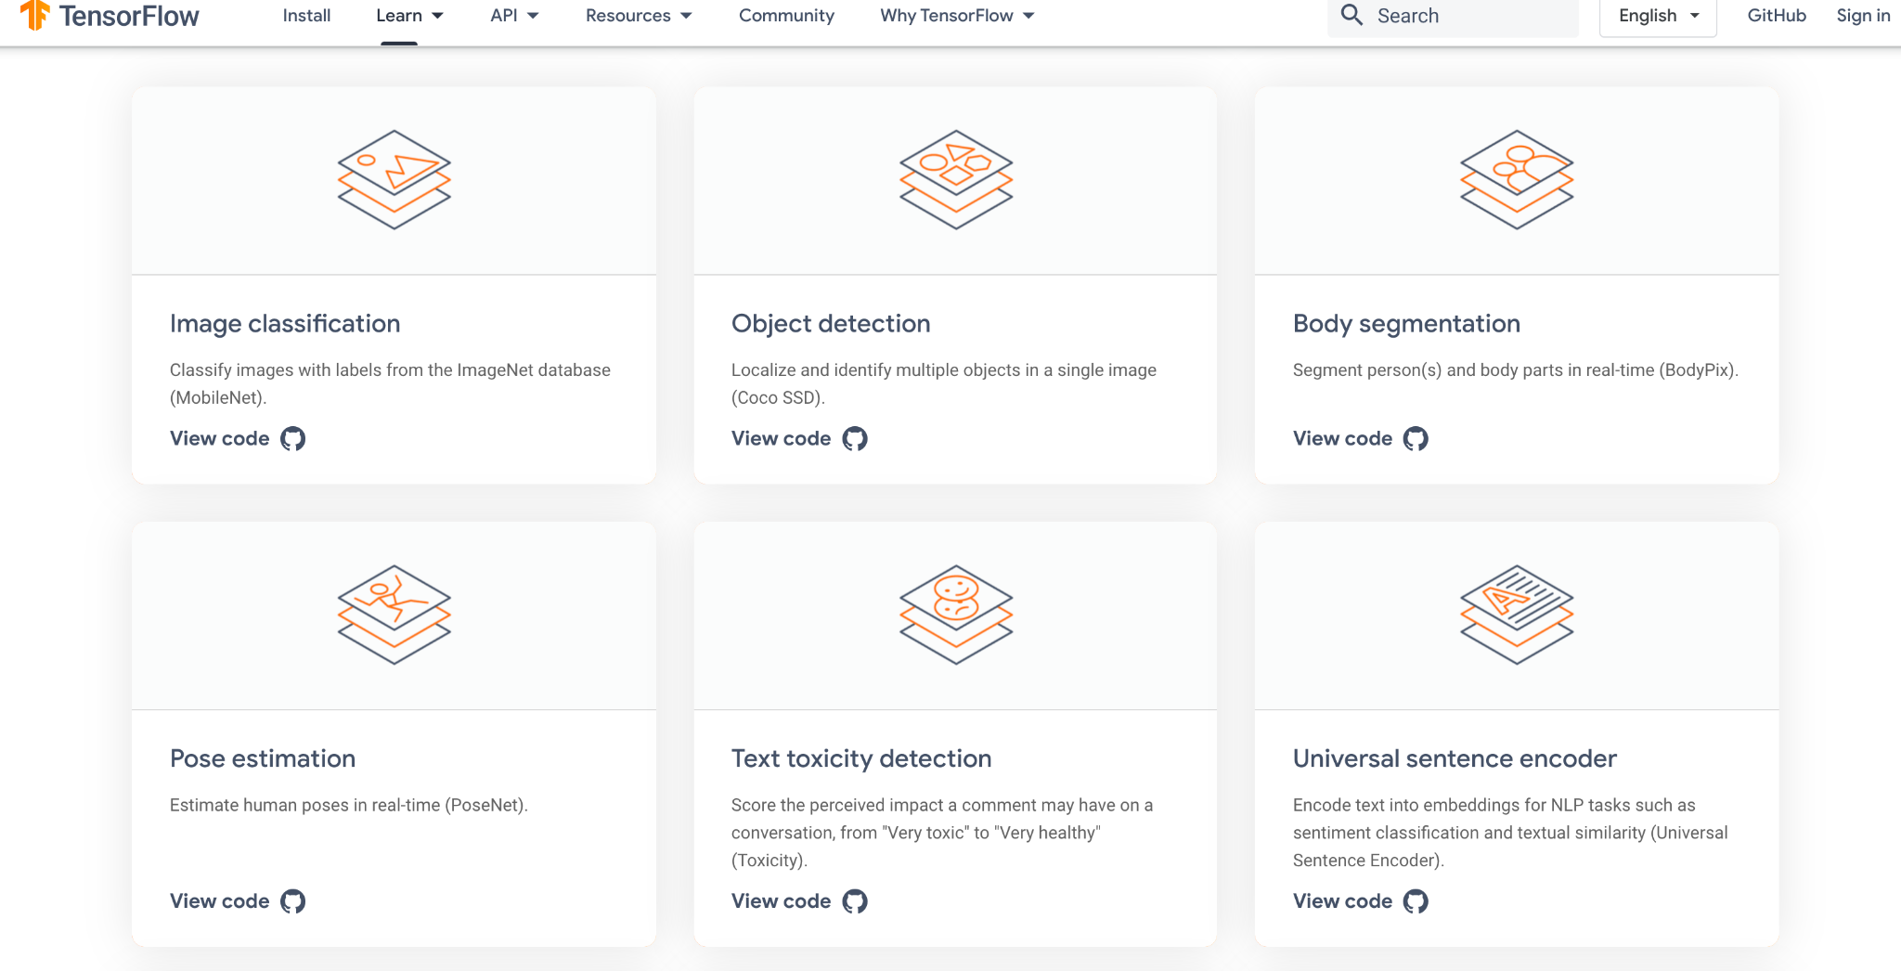
What is JS
Notes:
Tensorflow JS is a web framework which is tensorflow but completely rewrite in Javascript and can run in your browser.

Slide 9

It’s faster than you can imagine
Notes:
It is faster than you can imagine by using WebGL framework to use your GPU to accelerate.

Slide 10

No installation required!
Notes:
No installation required. All dependencies are shipped with the app and can run anywhere.

Slide 11
People love deep learning app!
Notes:
People love deep learning app

Slide 12
People love deep learning app!
Without too many configurations
Notes:
and people love deep learning app without too much configuration!

Slide 13
We are migrating the examples from our assignments to this web platform
Notes:
We are trying to migrate all the examples from the assignments to this web platform. Let me show you some examples.

Slide 14
Face Mask Detection and Object Detection
Notes:
First is face mask detection and object detection.

Slide 15

Image processing app with ML with millions of downloads
Face Changing app
Deep fake
… ...
Notes:
In the past few years, image processing apps with ML created a lot of downloads. We have a lot of face changing apps in our App store.

Slide 16
Object Detection application is a big deal
Notes:
However, for those one who want to apply deep learning in their jobs, the object detection application is always the number one priority.

Slide 17
However, develop such applications requires effort and knowledge
Notes:
However, developing such applications requires effort and knowledge.

Slide 18
In theory by not in reality
Notes:
Even though there are many codes online, they require some set up to run.

Slide 19
We want to simplify this process by using the power of Tensorflow JS
Notes:
So we simplify these processes by moving the python model to the web!

Slide 20

Demo
Notes:
Here is a short demo

Slide 21
We will migrate all the examples from assignments to this web platform

Slide 22
So that people can enjoy the power of the ML and Computer Vision easily

Slide 23
Playground
Notes:
We call this platform the playground.

Slide 24
A ML Playground for everyone!
Notes:
A ml playground for everyone

Slide 25

Face mask detection
Notes:
One interesting application in our web app is face mask detection. In today’s covid-19 situation, face masks are required in almost every public place. However, some people will still remove their face masks sometimes.

Slide 26
An automated face mask system built with Faster RCNN and deploy into our browser
Notes:
We design an automated face mask detection system built with Faster RCNN and deploy it into our browser.

Slide 27
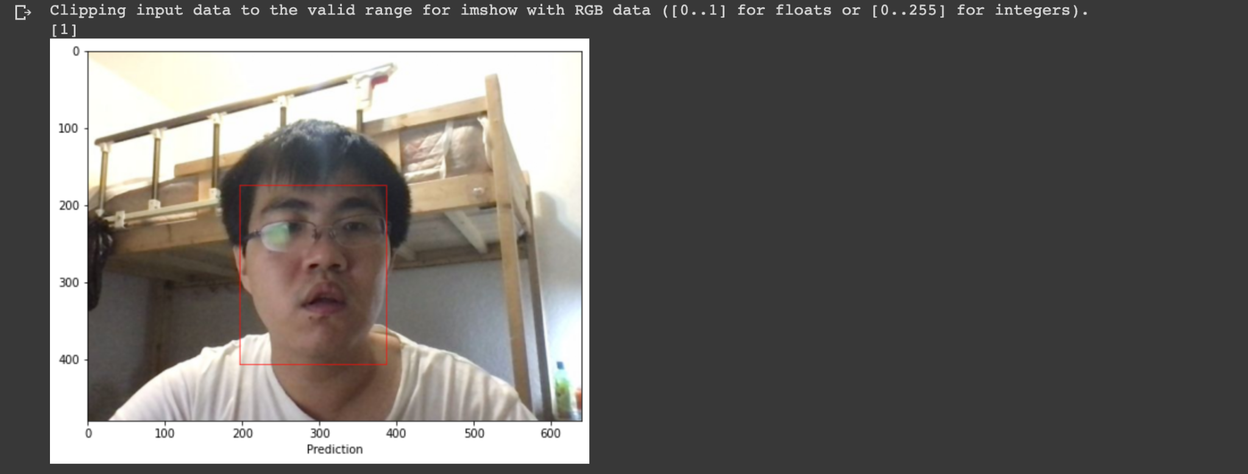
Notes:
You can set up this app on your iPad and put it into a public area. It will alert you when it finds someone without a face mask!

Slide 28
Customization = Yes!
Notes:
Customization? Yes! You can always upload your own model and use it.

Slide 29
Instant try = Yes!
Notes:
Instant try? Yes. Just go to our website and you will enjoy our pre-trained model!

Slide 30
Accuracy = High!
Notes:
Accuracy? Yes!

Slide 31
Hardware acceleration = Yes!
Notes:
And hardware acceleration? Yes! Enjoy your iPad’s 8 cores GPU! And of course, we don’t have any dependencies missing issues!

Slide 32
No dependencies missing = Yes!
Notes:
And of course, we don’t have any dependencies missing issues!

Slide 33

All will be migrated to your browser
Object Classification
Object Detection
Style Transfer
GAN
Linear Regression
… ...

Slide 34
Gan Network - DCGAN
(Level: Heavy Training)

Slide 35
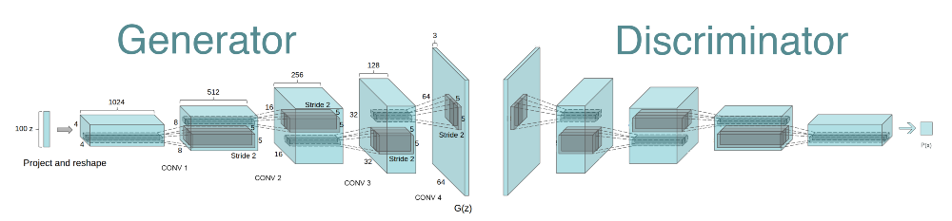
Model Architecture
The DCGAN architecture used was first started by Radford et al. (2015) and shown as below:

Slide 36
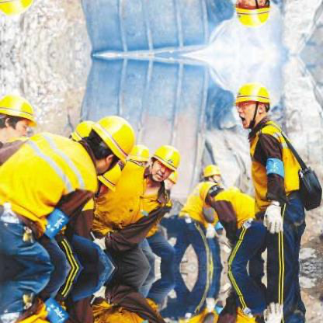
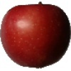
Datasets
Two different datasets are used:
Fruit images (simple)
Hard hat worker images (complicated)

Slide 37
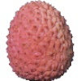
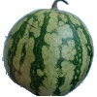
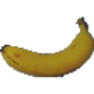
Datasets 1
Title: Fruits360 Dataset v5
Type: 13 classes of fruits will be selected for this project
Purpose of use: Dataset includes images which have comparatively simple scene than worker hard hat dataset
Size: 5000 out of 90483
Published Date: Apr 2020
Credit to: https://www.kaggle.com/moltean/fruits

Slide 38
Idea for the 1st Solution
(Dataset 1)
Direct load 5000 fruit images to DCGAN
Result: Good

Slide 39
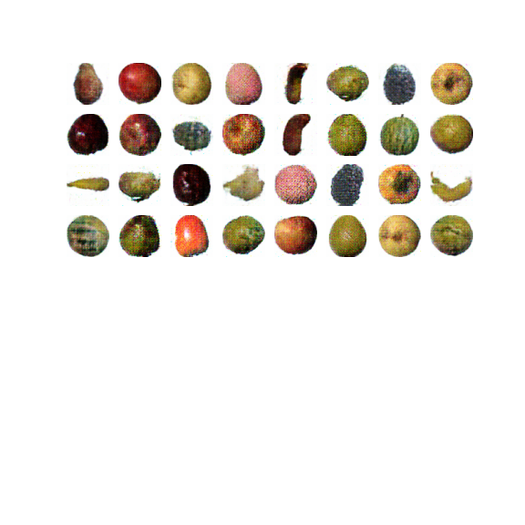
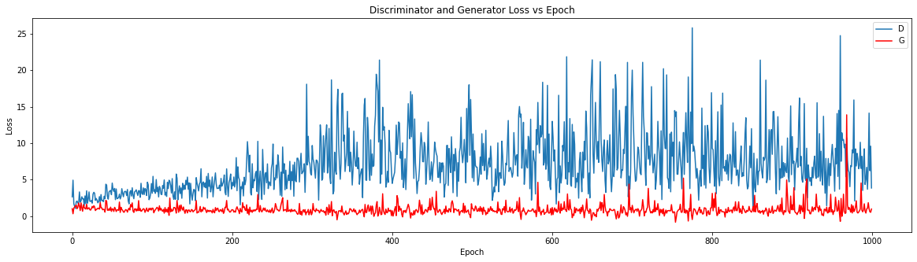
Dataset 1 - Performance - 1st Solution
Good
Stabilized G Loss

Slide 40
Hyperparameters - 1st Solution
(Dataset 1)
Hyperparamters | Value
Number of CNN Layers | 5
Input image size | 64x64
Batch Size | 64
Optimizer & Learning Rate | tf.compat.v1.train.AdamOptimizer(1e-4)
Activation Function | LeakyRelu (alpha = 0.2)
Regularization | Dropout 0.3
Loss Function | tf.compat.v1.losses.sigmoid_cross_entropy
epoch | 1000

Slide 41
Try a complicated scene with the same DCGAN…..
Worker hard hat datasets

Slide 42
Datasets 2
Title: Hard Hat Worker Dataset
Type: Images of construction worker at construction site in which contain helmet, workers, site environment, equipments etc
Purpose of use: The Dataset includes images which have comparatively complicated scene than Fruits360 datasets
Size: 5000
Publised Date: 28 Jul 2020
Credit to: https://makeml.app/datasets/hard-hat-workers

Slide 43
Idea for the 1st Solution
(Dataset 2)
Simply follow the model architecture and hyperparameters used for Fruit datasets
Result: Room to improve

Slide 44
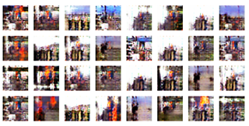
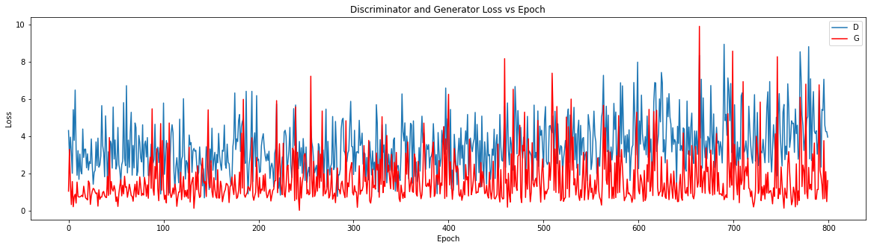
Dataset 2 - Performance -1st Solution
Not Good
Both D & G Loss are unstable

Slide 45
Hyperparameters - 1st Solution
(Dataset 2)
Hyperparamters | Value
Number of CNN Layers | 5
Input image size | 64x64
Batch Size | 64
Optimizer & Learning Rate | tf.compat.v1.train.AdamOptimizer(1e-4)
Activation Function | LeakyRelu (alpha = 0.2)
Regularization | Dropout 0.3
Loss Function | tf.compat.v1.losses.sigmoid_cross_entropy
epoch | 800

Slide 46
Idea for the 2nd Solution
(Dataset 2)
Give some tricks:
Add more filters and increase the conv layers
Use smaller batch size (from 64 to 8)
Use ReLu instead of Leaky ReLu
Increase lr from 1e-4 to 0.0002
Add Guassian Noise to both Real & Fake image
Gaussian Weight Initialization for G & D
Label Smoothing (for both +ve & -ve)

Slide 47
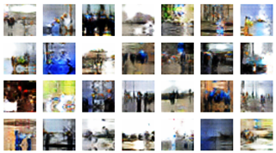
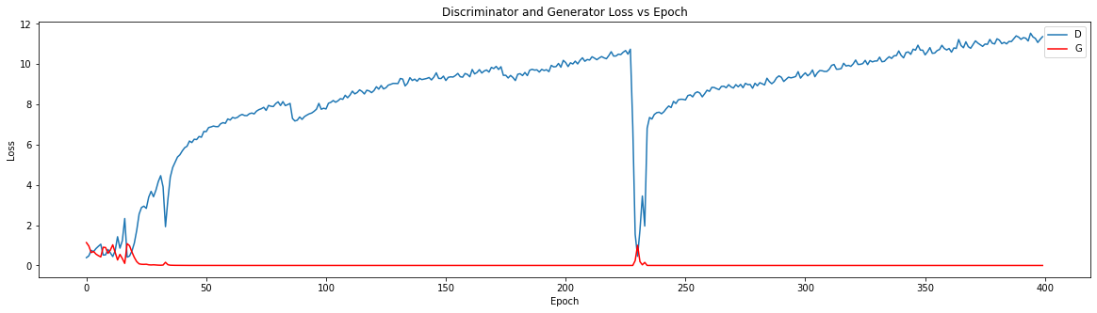
Performance - 2nd Solution
Better than 1st solution
Both D & G Loss Stabilized

Slide 48
Hyperparameters - 2nd Solution
Hyperparamters | Value
Number of CNN Layers | 6
Input image size | 64x64
Batch Size | 8
Optimizer & Learning Rate | tf.compat.v1.train.AdamOptimizer(0.0002)
Activation Function | ReLU (alpha = 0.2)
Trick 1 | Add Gaussian Noise to real and fake image
Trick 2 | Use Gaussian Weight Initialization for G & D
Trick 3 | Label Smoothing

Slide 49
Implications -> Third Solution
After the previous experiments, we need some future improvement
Multi-Scale Gradient

Slide 50
Key Learning of DCGAN project
The concept of GANs is not that hard to understand. But the implementation to produce quality images can be difficult.
Different dataset required different DCGAN architecture and Training Tricks (combination of hyperparameters to handle the mode instability and quality)
GPU is highly required - MS Azure Lab > Colab > Colab Pro
Spend countless hours for a good outcome
High learning rate will cause Mode Collapse
Familiar with Tensorflow and Keras after the project

Slide 51
Face Recognition
by Transfer Learning
(Level: Optimized Training)

Slide 52
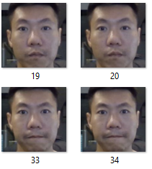
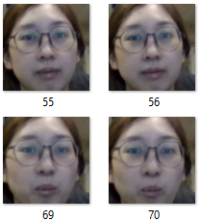
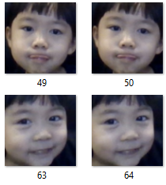
Datasets
Title: Paddy’s Family (My wife and daughter)
Purpose of use: For image recognition by calculating the similarity %
Size: 300 images processed by OpenCV
Published Date: Apr 2021

Slide 53
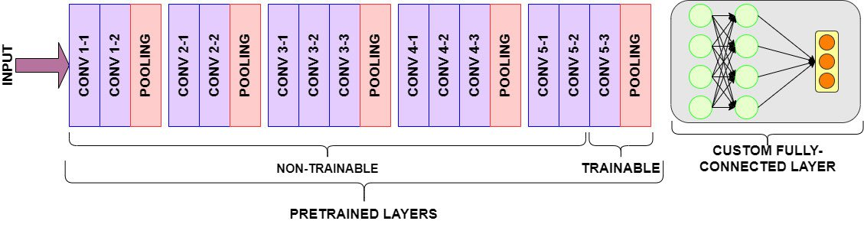
Model Architecture - VGG16
Dense Layer x 3

Slide 54
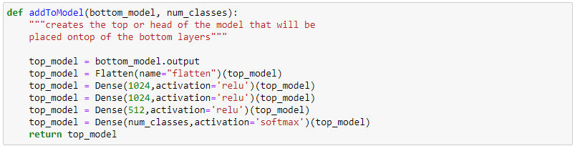
Implementation - Define Custom Layers
Convenient and Easy to use: Just 3 Steps
Creates the top or head of the model that will be placed on top of the bottom layers
STEP 1

Slide 55
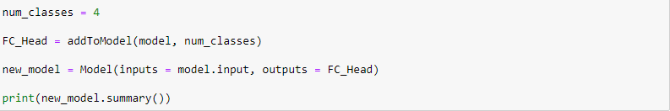
Implementation - Add to the Pretrained Layers (VGG16)
Convenient and Easy to use: Just 3 Steps
STEP 2
STEP 3

Slide 56
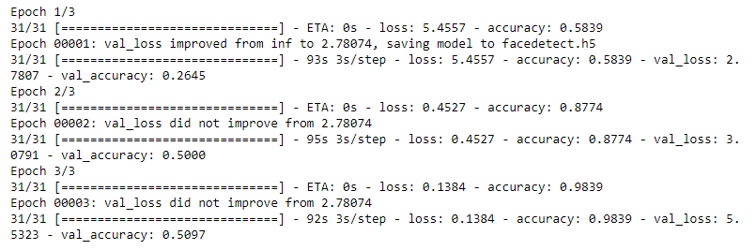
Performance

Slide 57
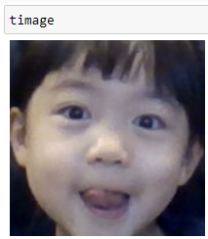
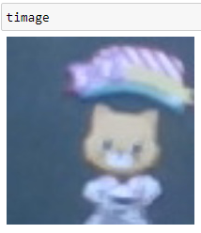
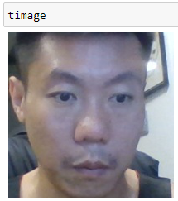
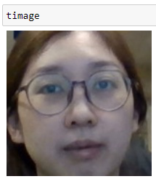
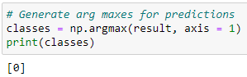
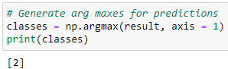
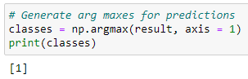
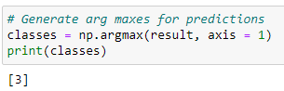
Result
Class Indices: {'Lydia': 0, 'Others': 1, 'Paddy': 2, 'Venus': 3}

Slide 58
Future Improvement
Use a larger dataset with varying angle of faces to train the model

Slide 59
Face Detector
by DLib
Introduction to a Face Detector Library
(No need Training - ready to use)

Slide 60
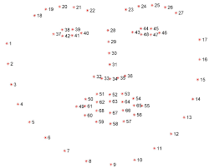
What is Dlib
A Python package wraps face recognition functions into a simple, easy to use API
Two face detection method were built into the library
2.1 HOG & Linear SVM face detector - for frontal face detection
2.2 Max-Margin (MMOD) CNN face detector - for vary angle face detection

Slide 61
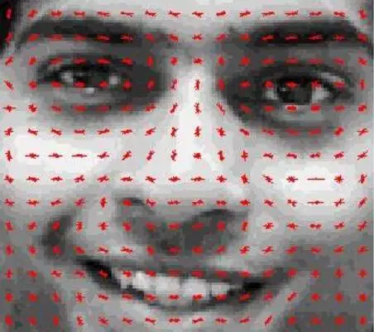
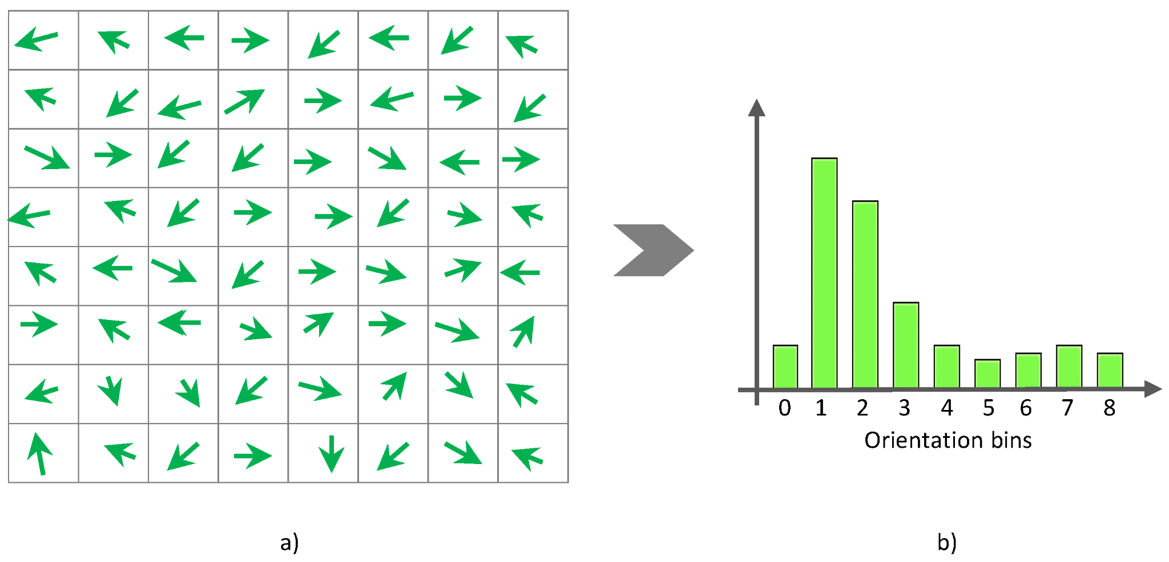
Model Architecture
HOG + Linear SVM

Slide 62
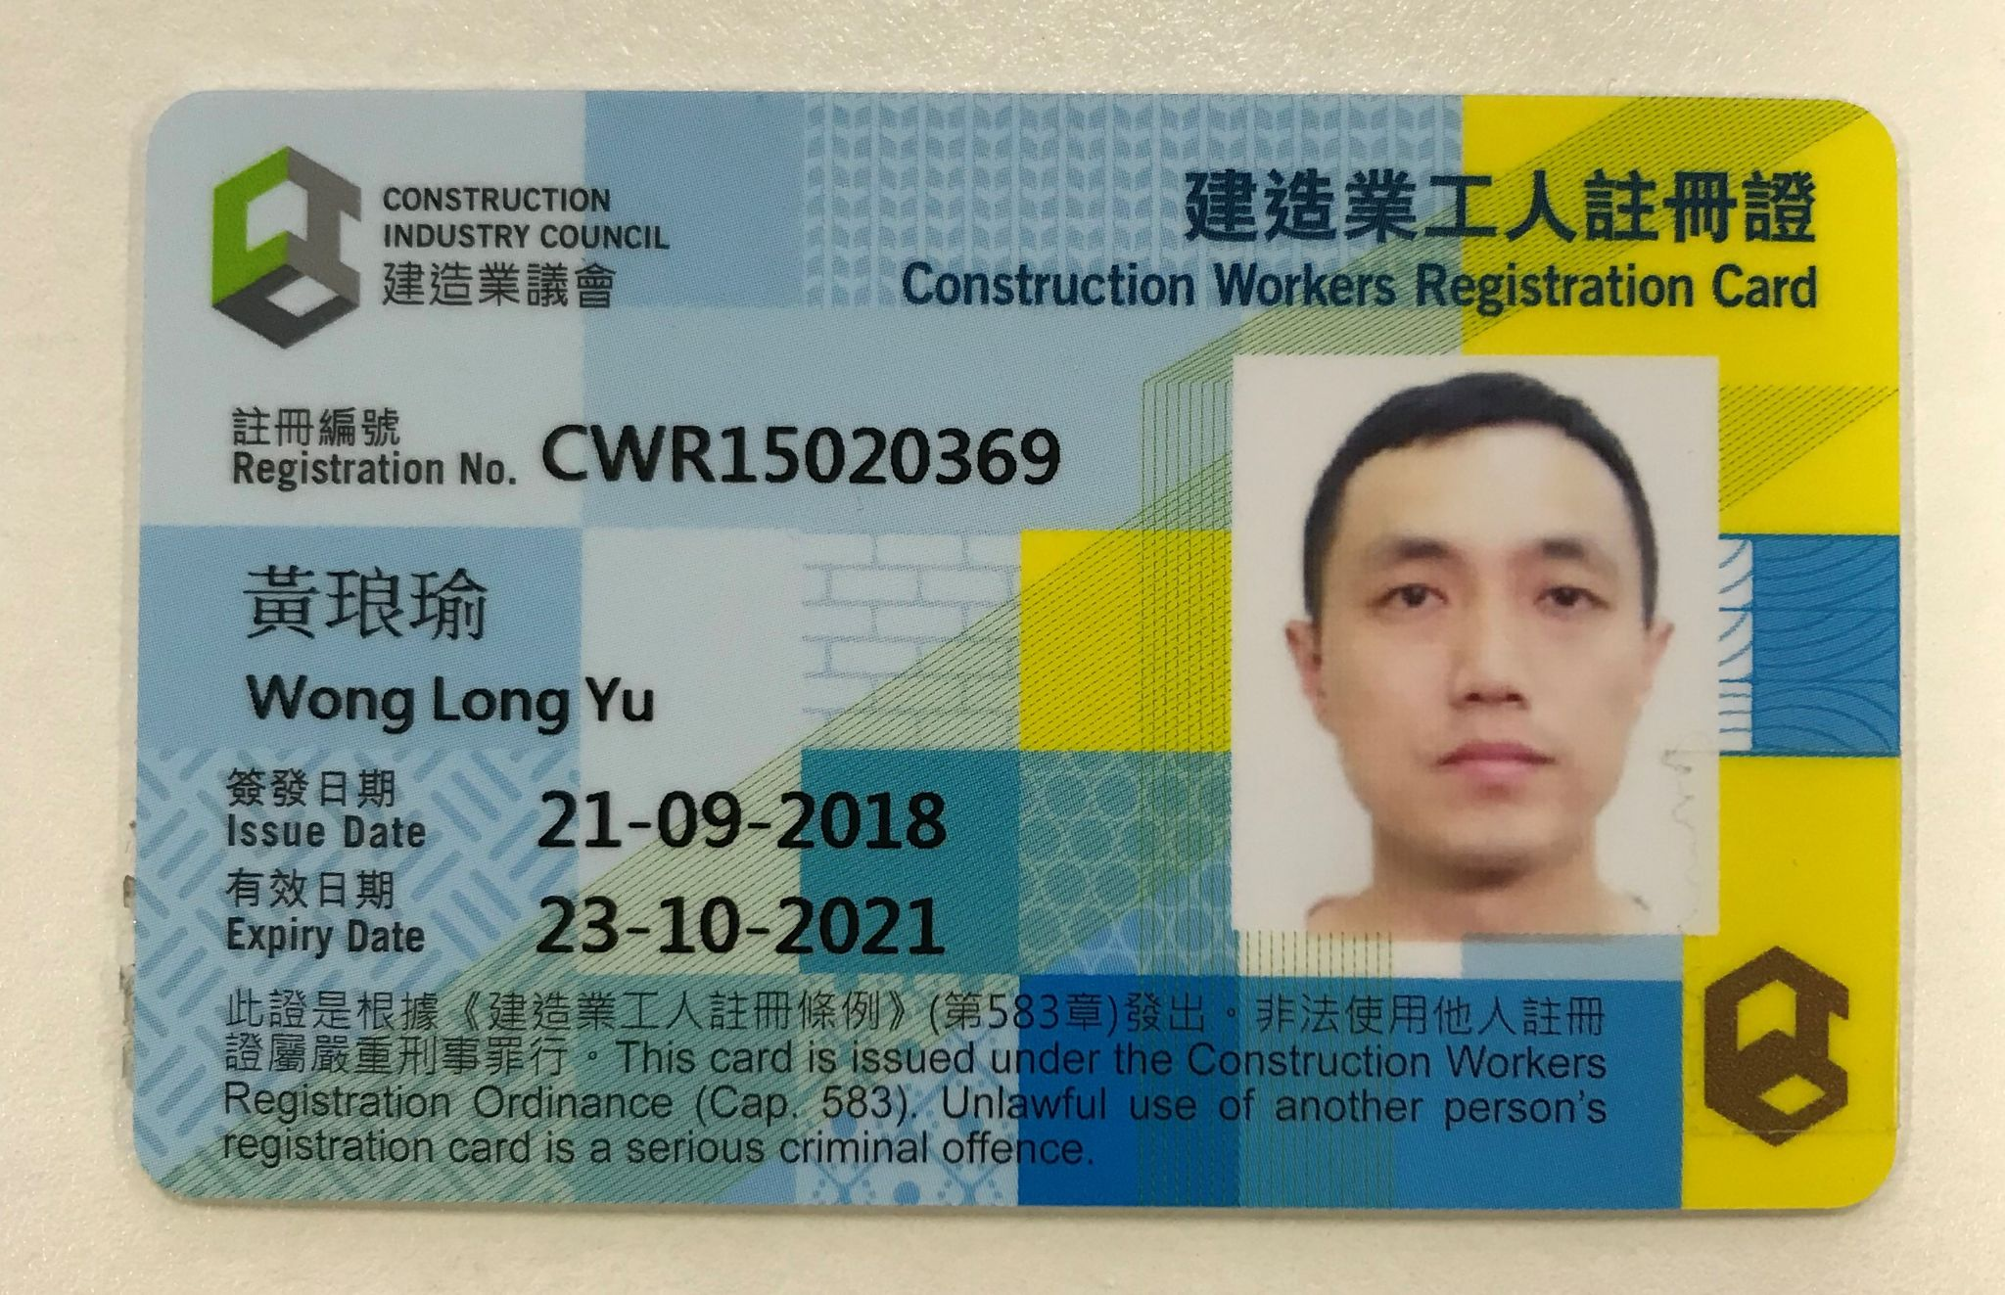
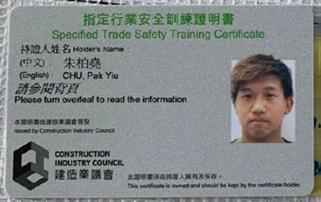
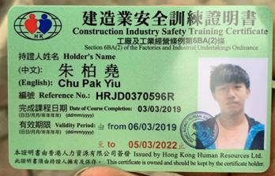
Datasets
Title: Worker Qualification ID Card
Purpose of use: Detect and crop the face for other usage
Size: 10 images
Published Date: Apr 2021

Slide 63
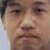
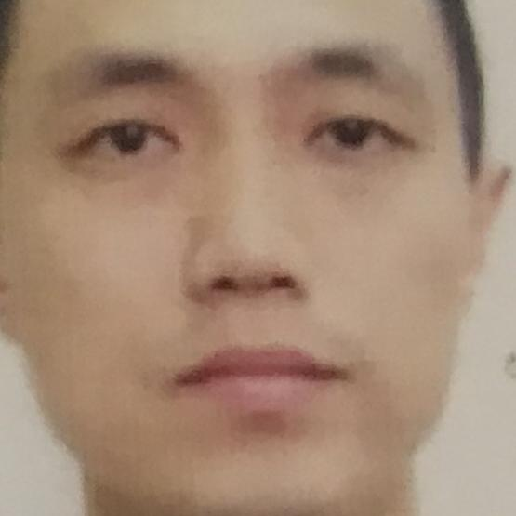
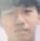
Result

Slide 64
Result
Highly streamline my company worker qualifications registration process when do together with the OCR to capture the name and other qualification information

Slide 65
END
Q&A

